Slide 1
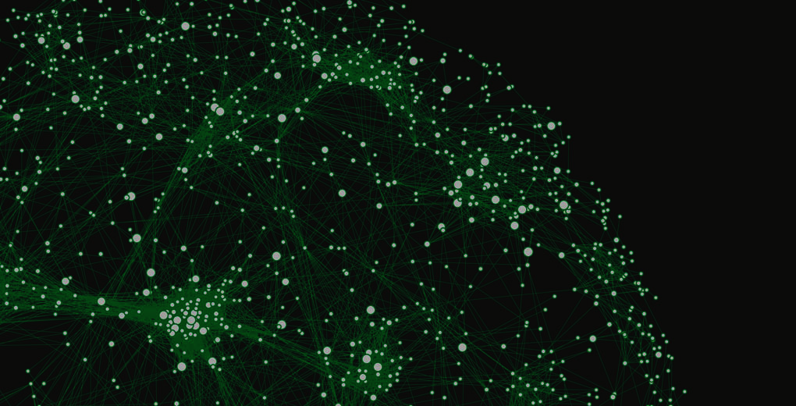

The Sparks Foundation
Data Science & Business Analytics Intern
TASK – 2 : Prediction Using Unsupervised Learning (K-Means Clustering)
Author : Sagar Kishore Dakua

Slide 2

Prediction Using Unsupervised ML:
Machine Learning: K-Means Clustering
Language: Python
IDE: Jupyter Notebook
Libraries: Pandas, Scikit Learn, Matplotlib

Slide 3
K-Means Clustering in Machine Learning:
K-means clustering is one of the simplest and popular unsupervised machine learning algorithms.
K-means is a centroid-based algorithm, or a distance-based algorithm, where we calculate the distances to assign a point to a cluster. In K-Means, each cluster is associated with a centroid.

Slide 4
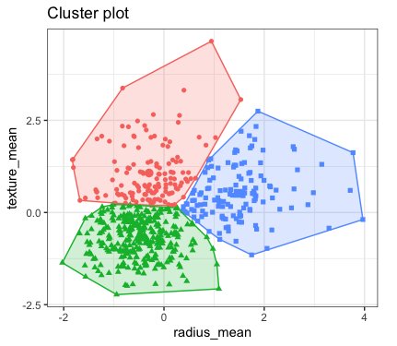
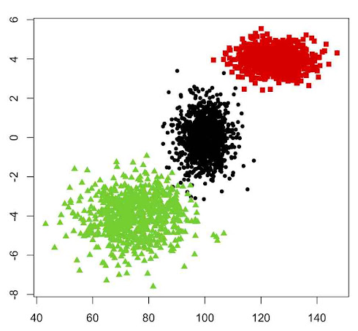
K-Means Clustering in Machine Learning:
Examples

Slide 5
The Elbow Method:
The elbow method is used to determine the optimal number of clusters in k-means clustering. The elbow method plots the value of the cost function produced by different values of k.
As we know, if k increases, average distortion will decrease, each cluster will have fewer constituent instances, and the instances will be closer to their respective centroids. However, the improvements in average distortion will decline as k increases.
The value of k at which improvement in distortion declines the most is called the elbow, at which we should stop dividing the data into further clusters.

Slide 6

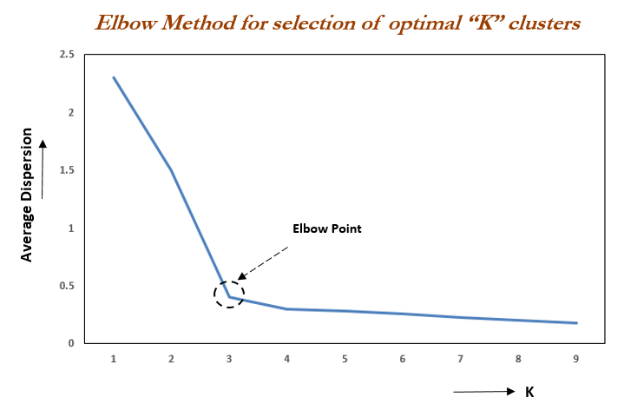
The Elbow Method:

Slide 7
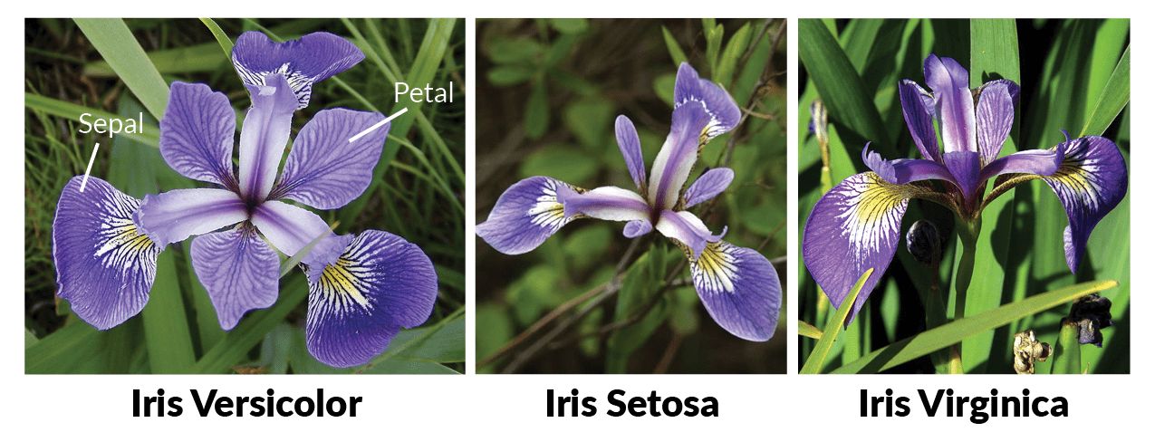
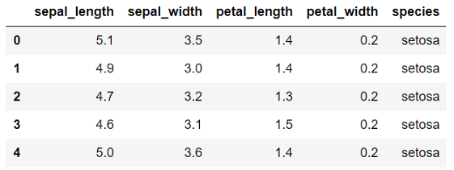
Iris Dataset

Slide 8

Let’s quickly dive into Jupyter Notebook

Slide 9
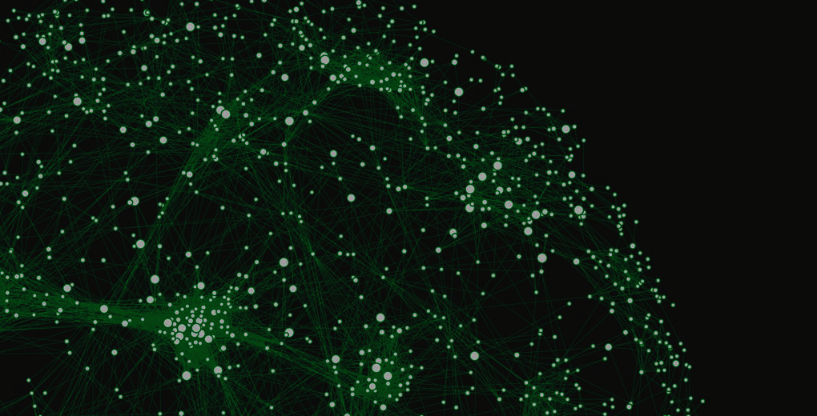
Thank You
Please post in the comment section for queries & suggestions.

